Slide 1


Robert Hastings
Chief of Staff and Executive Vice President,
Communications and Government Affairs

Slide 2



Slide 3
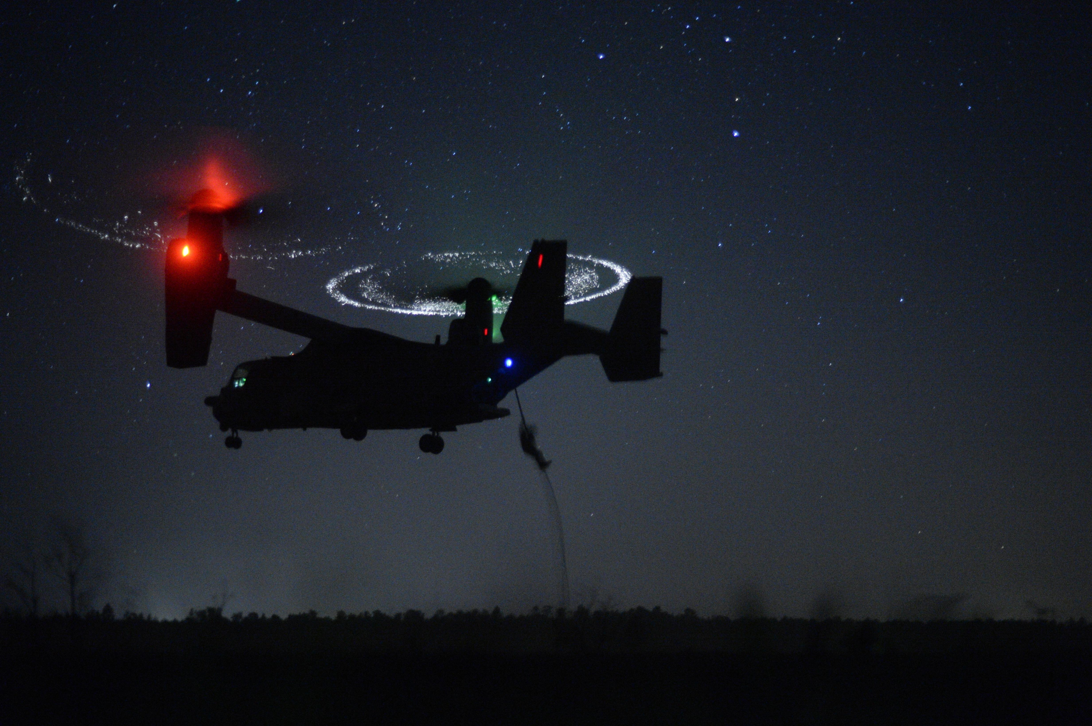
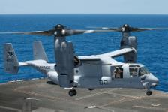
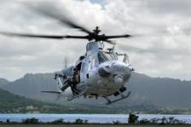
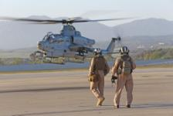
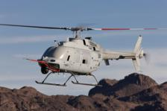
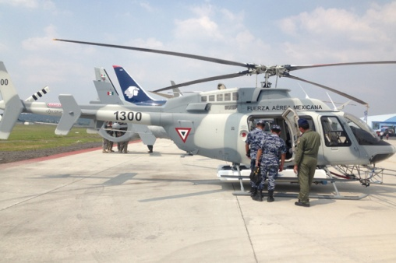
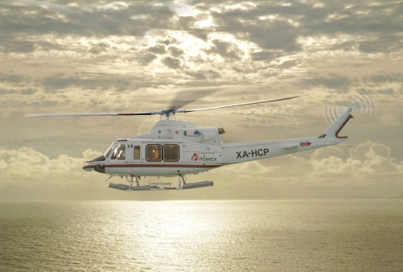
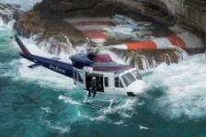
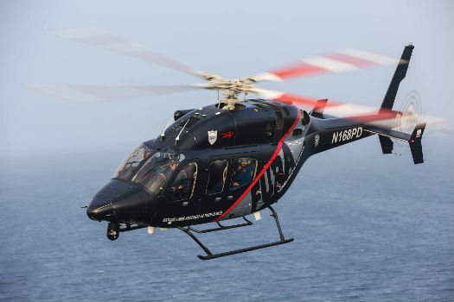
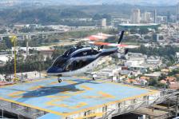
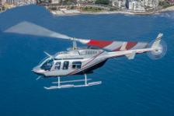
Bell Helicopter Existing Product Lines
Bell Boeing CV-22
Bell Boeing MV-22
Bell UH-1Y
Bell AH-1Z
MQ-8C Fire Scout
Bell 407GXP
Bell 412EP
Bell 412EPI
Bell 429
Bell 429WLG
Bell 206L4
Bell 206L4

Slide 4
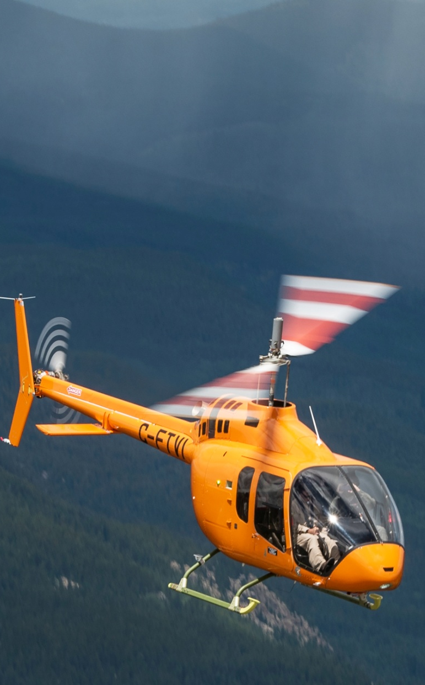
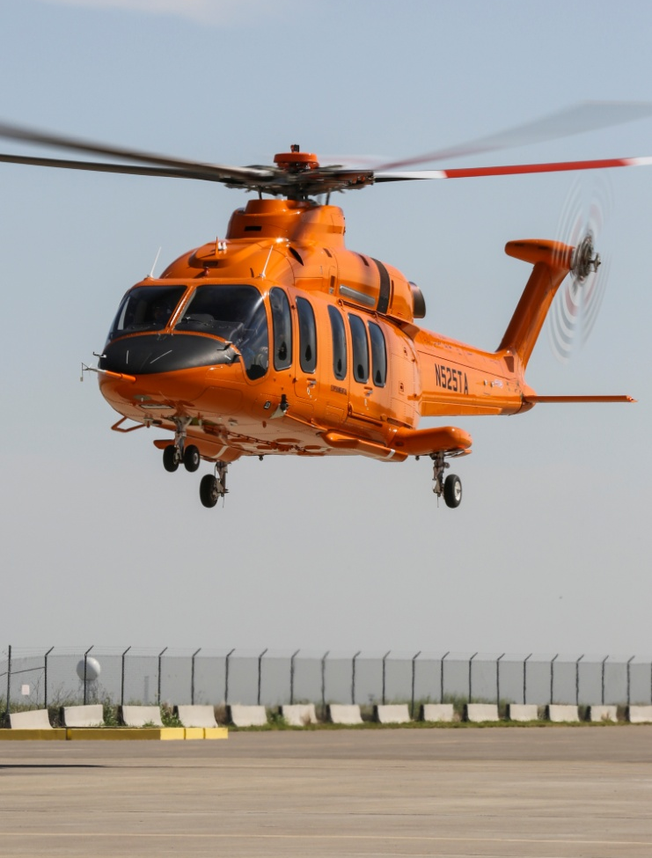

Three New, Clean-Sheet Design Aircraft
Bell 505 Jet Ranger X
Bell 525 Relentless
Bell V-280 Valor Tiltrotor

Slide 5
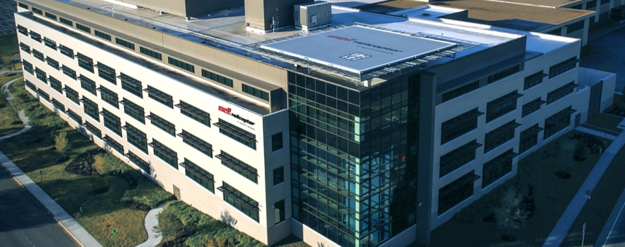
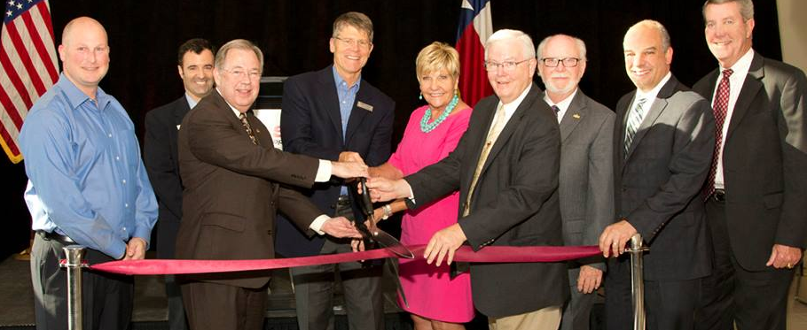
Bell Helicopter in Tarrant County
Revitalized Main Campus
Logistics Center
Drive Systems Center
Xworx Facility
New Bell Training Academy
  Capacity for 4,000+ pilots and maintainers per year
  Emergency Medical Services, Law Enforcement, Firefighting
50,000 Visitors Last Year
Projected $38.4 Billion Economic Impact Over the Next 10 Years

Slide 6
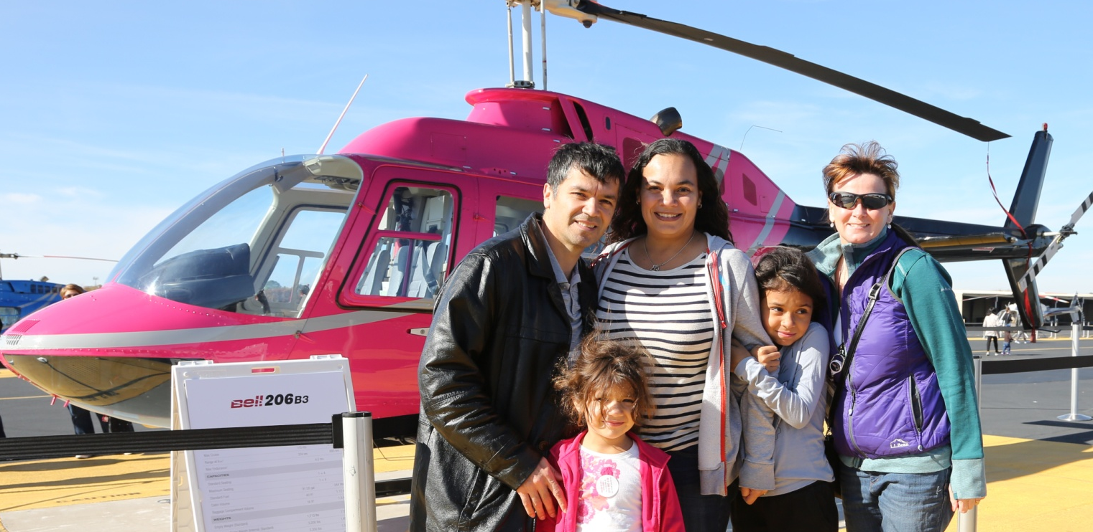
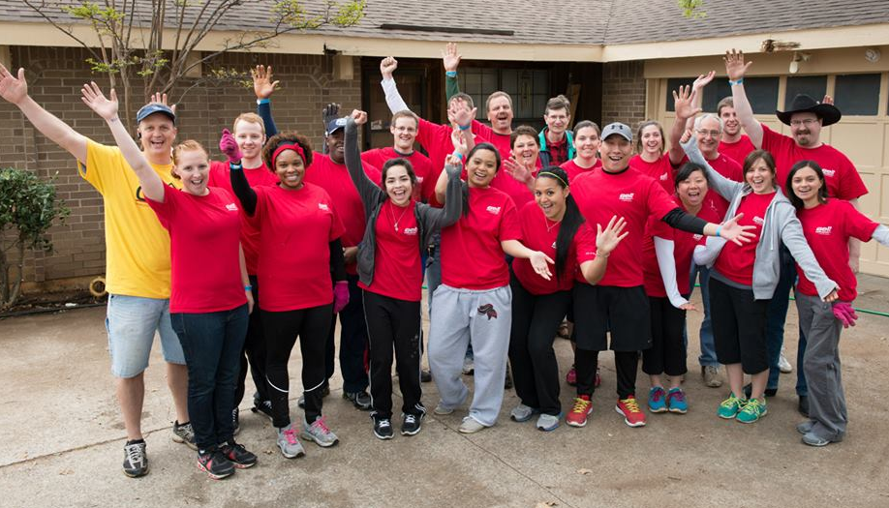
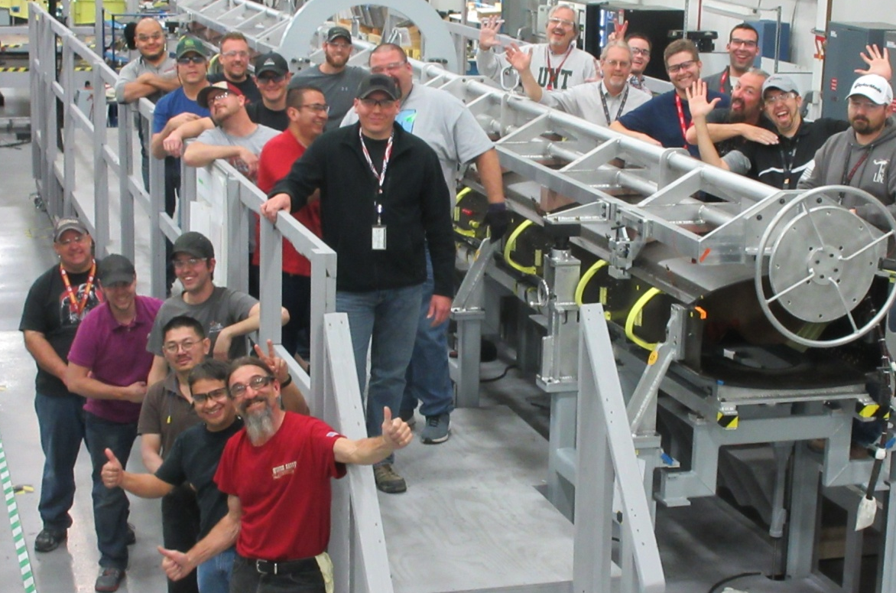
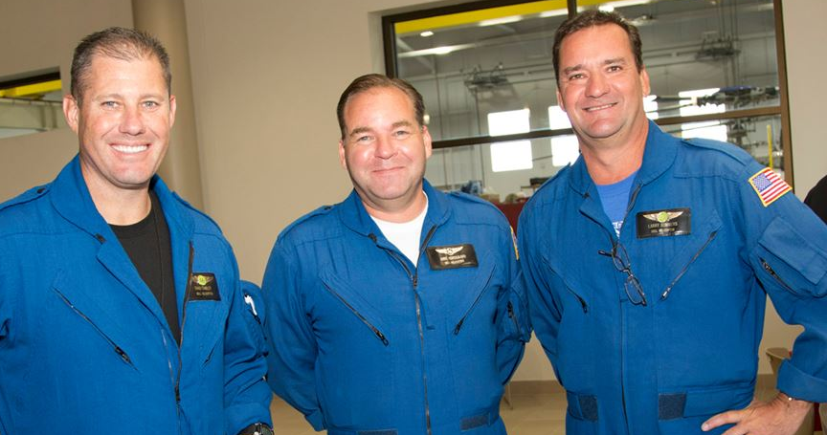
THANK YOU!

