Slide 1


The Future of Transit and Commuter Rail in Tarrant County
TEX Rail Update and T Master Plan
Paul J Ballard
President & Chief Executive Officer
Fort Worth Transportation Authority (The T)
6th Annual Northeast Tarrant Transportation Summit
February 13, 2015

Slide 2

P2 2/13/15
Notes:
Click on link to play video

Slide 3
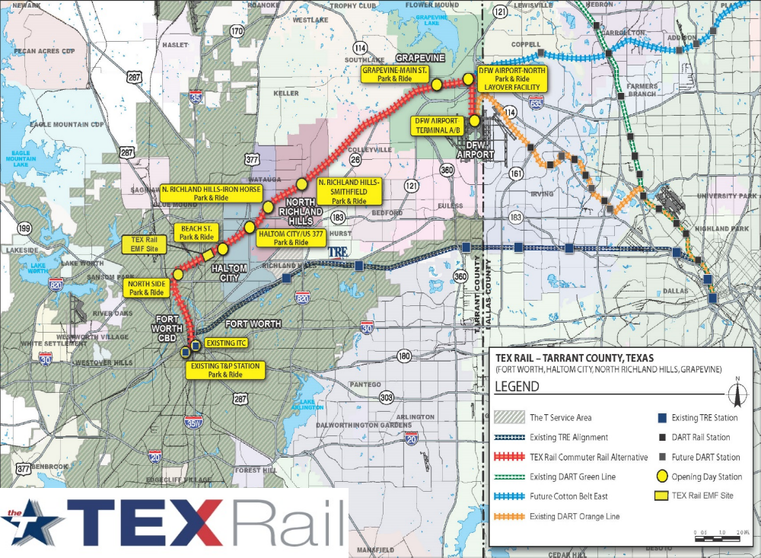
TEX Rail Map
P3 2/13/15

Slide 4
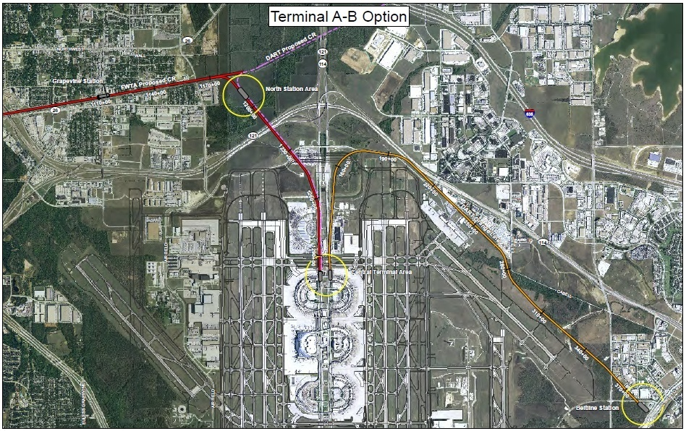

DFW Rail Access
P4 2/13/15

Slide 5
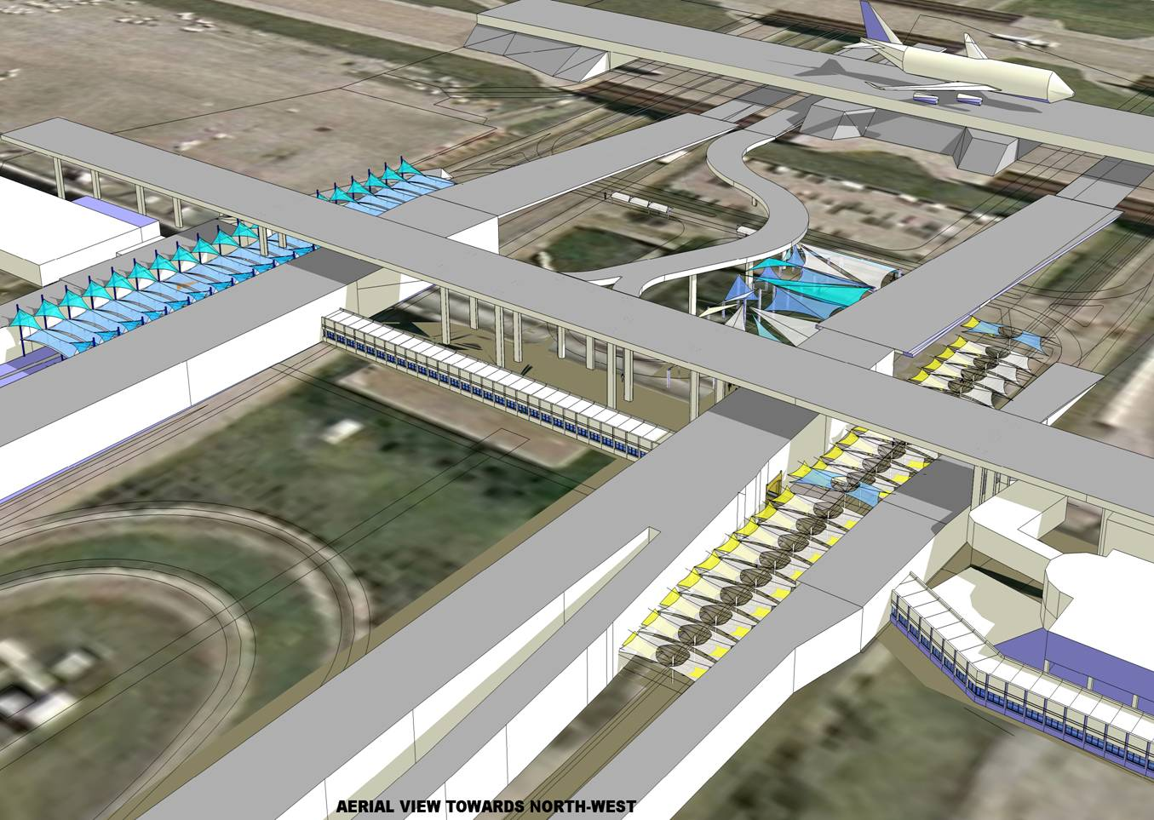

Terminals A-B Station Concept
Terminal B
Employee
Drop-off Area
The T Station
DART Station
Terminal Connector
Terminal A
P5 2/13/15

Slide 6
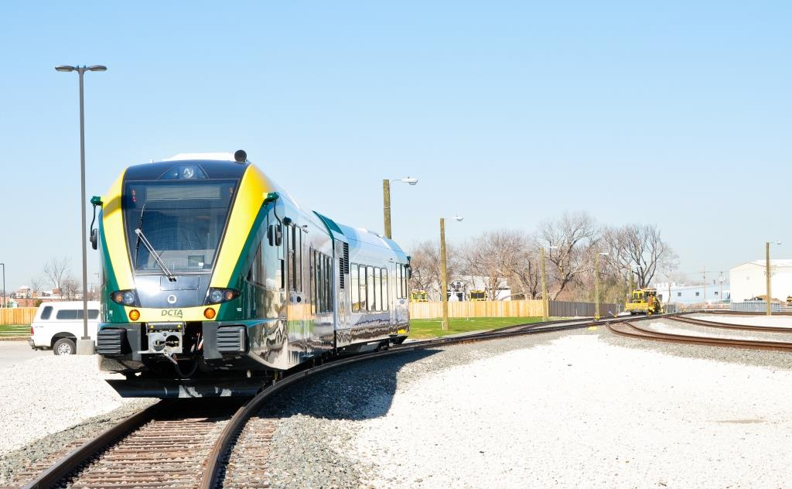
P6 2/13/15
Photo of DCTA’s A-train

Slide 7
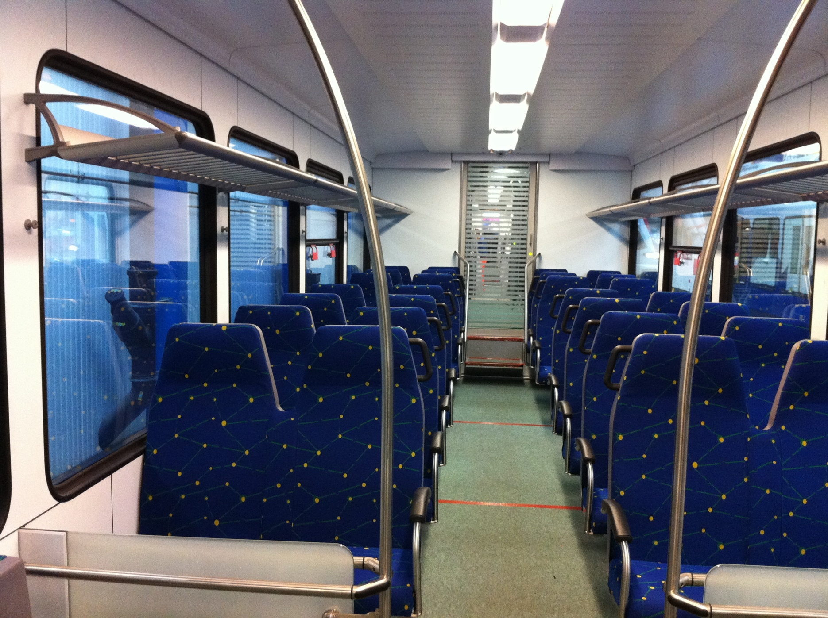
P7 2/13/15
Photo of DCTA’s A-train

Slide 8
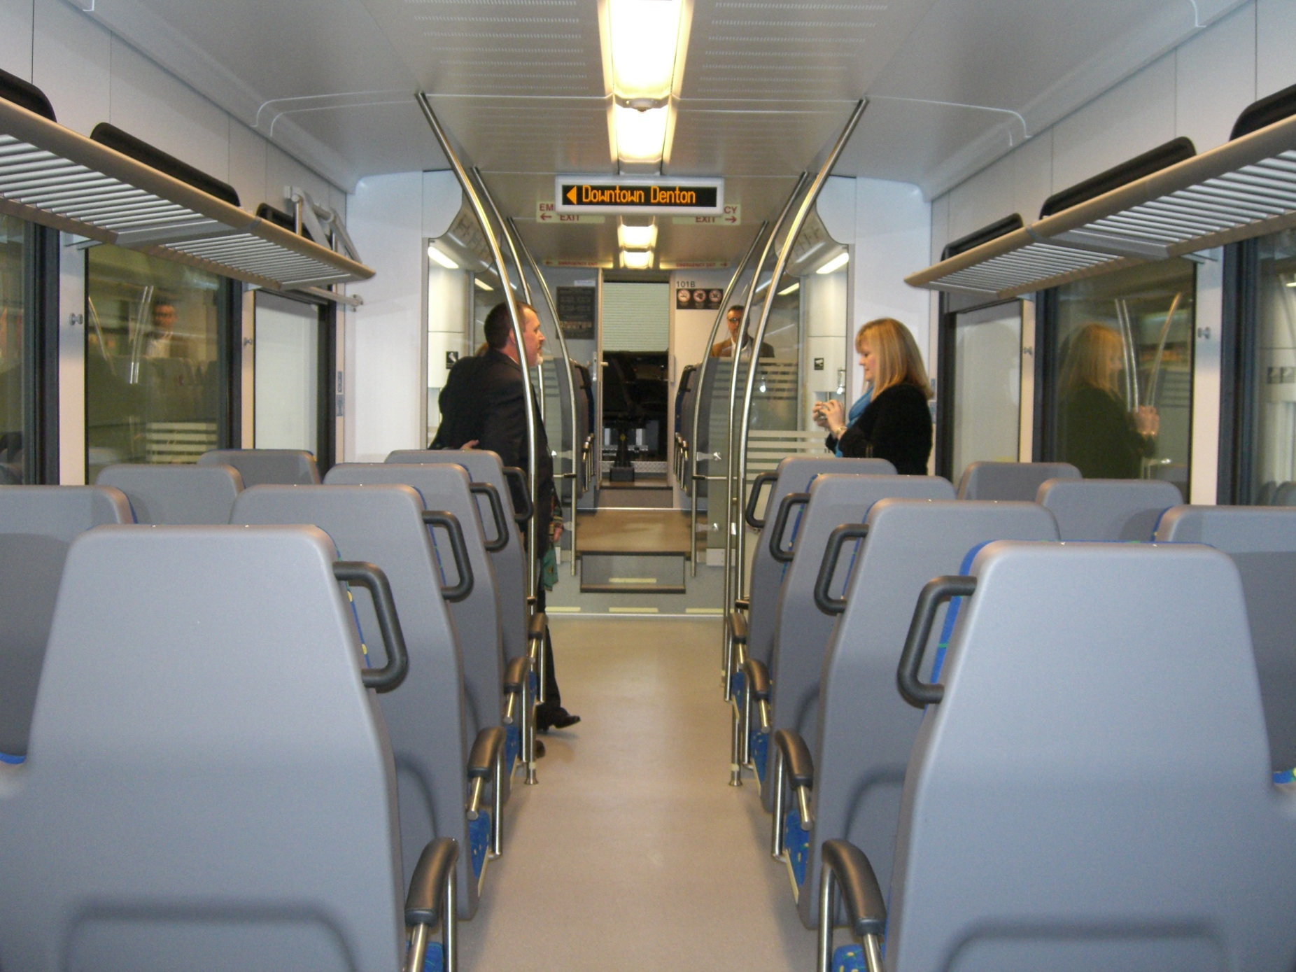
P8 2/13/15
Photo of DCTA’s A-train

Slide 9

TEX Rail Project Funding Through 2019 when Short Term Construction Debt is Retired
Primarily Sales Taxes from the City of Fort Worth
6
2/12/15
P9 2/13/15

Slide 10
Connection in progress
Included in the President’s FY15 Budget
FY15 New Starts rating Medium-High
FY16 New Starts Annual Update submitted and under evaluation by the FTA
Included in President’s FY16 Budget - $100,000,000
Record of Decision received September 2014
P10 2/13/15

Slide 11
Schedule
Issued RFP for CMGC Contractor – Dec 2014
Award Vehicle Contract – Early 2015
Full Funding Grant Agreement Award – Q1 2016
Revenue Service – 2018
P11 2/13/15

Slide 12
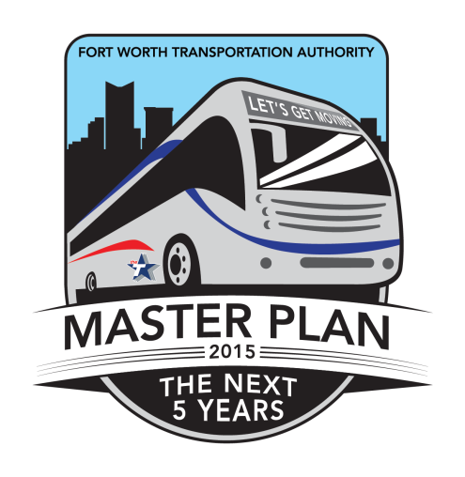
T Master Plan
Mobile Meetings
Public Meetings
Mind Mixer
Social Media
Community Involvement
Five Year Service Plan
Funded by the North
Central Texas Council
of Governments
P12 2/13/15

Slide 13
End Result
Comprehensive Plan with maps and visuals laying out what we and the Community feel should be our network of public transportation in the future
P13 2/13/15

Slide 14
The T Ridership for All Modes
FY 2003-2014
P14 2/13/15

Slide 15

Questions?
Paul J Ballard
President & Chief Executive Officer
pballard@the-t.com
817-215-8704

