Slide 1

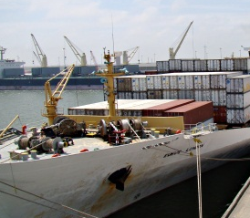

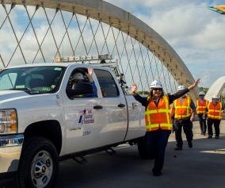



Panama Canal Expansion
Impact of the Expansion Project on Our Region’s Mobility
February 19, 2016

Slide 2
Table of Contents
1
Overview of Panama Canal Expansion
3-7
2
Impact on Texas Ports & Economic Opportunities
8-11
3
Texas Panama Canal Initiatives
12
4
Port Actions
13-15
5
Texas Freight Mobility Plan
16
6
Texas Freight Network (Highways, Rail, & Logistics)
17-22
7
Conclusions
23

Slide 3
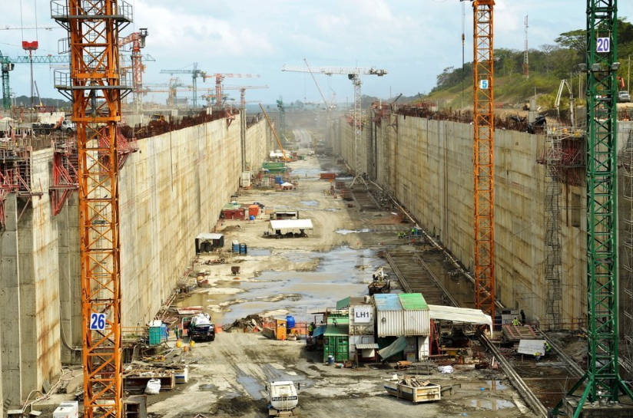
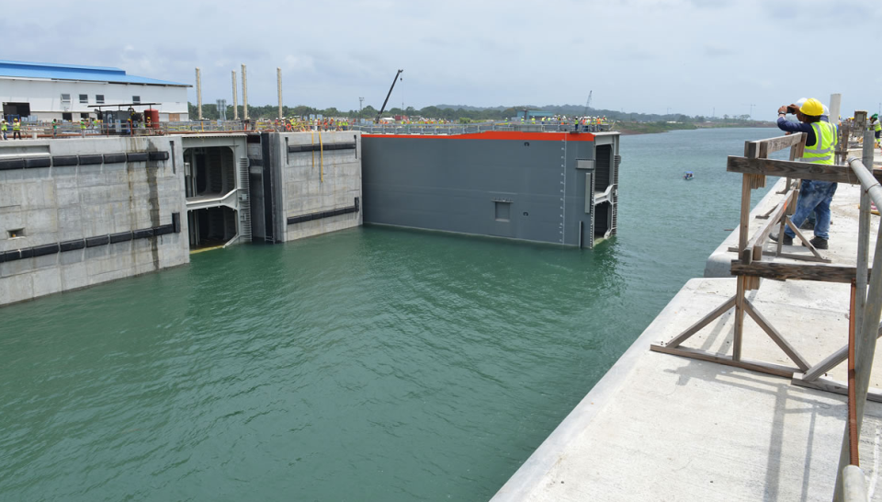
Overview of Panama Canal Expansion
Construction of third set of locks that will allow transit of larger vessels
Projected to reduce shipping delays and potentially reduce shipper costs
Expected to increase the annual carrying capacity from 340.8 million tons to 600 million tons
Project: 96% complete (as of December 31, 2015)
Estimated opening: June 2016
Source: Panama Canal Authority
Source: Panama Canal Authority
Notes:
Originally scheduled to open in 2014, but faced setbacks
Navigation tests to begin April 2016

Slide 4
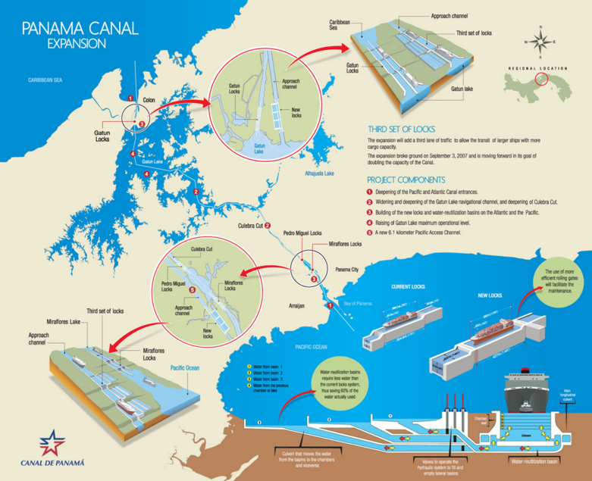
Overview of the Panama Canal Expansion
Source: Panama Canal Authority

Slide 5
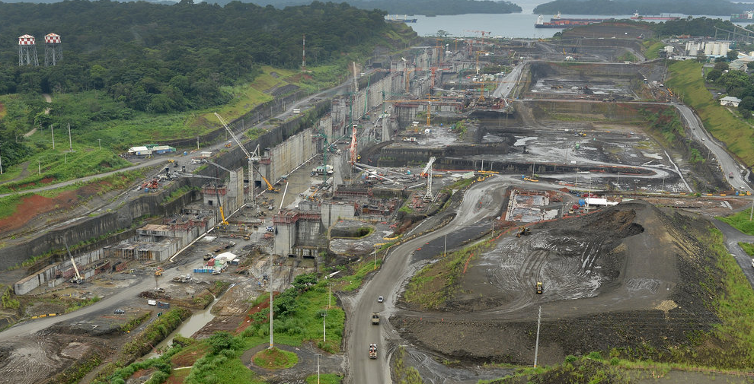
Overview of the Panama Canal Expansion
Source: Panama Canal Authority

Slide 6
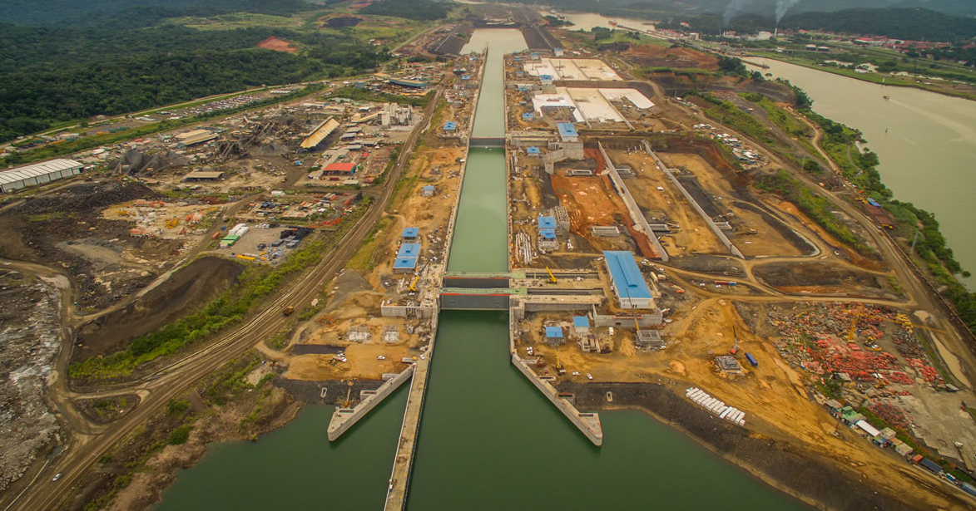
Overview of the Panama Canal Expansion
Source: Panama Canal Authority

Slide 7
Overview of Panama Canal Expansion
Dimensions of Existing Locks and New Locks of the Panama Canal
Dimensions | Existing Locks | New Locks
Length | 1,000 feet | 1,400 feet
Width | 110 feet | 180 feet
Depth | 42 feet | 60 feet
Dimensions of Panamax and New Panamax Vessels
Dimensions | Panamax Vessels | New Panamax Vessels
Length | 965 feet | 1,200 feet
Width | 106 feet | 160 feet
Draft | 39.5 feet | 50 feet
Container Capacity | 4,400 TEU | 13,000 TEU
Notes:
Explanation of Panamax vs. New Panamax
New locks will accommodate much larger vessels, though the largest of New Panamax vessels will not be able to call on Texas ports

Slide 8
Impact on Texas Ports & Economic Opportunities
Findings of the Texas Panama Canal Stakeholders Group (2012):
  The expansion represents an opportunity to expand Texas’ position as a global gateway for the nation
  As a leading exporter, Texas is well-positioned to take advantage of the expansion to increase exports to new and existing markets, particularly the LNG export market
  Texas must develop processes that provide a transportation system focused on commerce
  The potential for increased freight traffic through Texas ports may require system preservation and capacity improvements to rail, water, and highway infrastructure
Notes:
TxDOT formed the Panama Canal Stakeholder working group in early 2012 to assess the opportunities associated with the Panama Canal expansion for Texas
Included: shippers, carriers, ports, MPOs, RMAs, public agencies, industry groups, universities, and consultants
Report published in November 2012 (outline of findings on slide)
Recommendations included the development of the TxDOT MRD, Texas Freight Advisory Committee and Texas Freight Plan

Slide 9
Impact on Texas Ports & Economic Opportunities
Larger ships will be able to call at Texas ports, however at current channel depths, Texas ports will not be able to accommodate the largest of the New Panamax vessels (50 ft.)
A few Texas ports will likely experience noticeable increases in cargo volumes, but increases will most likely not be dramatic in the immediate term
Trade patterns will most likely coincide with population increases and economic growth
Currently, Texas ports handle 550 million tons of freight annually; expected to increase to more than 766 million tons by 2030
Ports will need to make infrastructure and channel improvements to remain competitive
Texas may be able to capture a share of the markets served by West Coast ports, however most large ships will continue to call on the West Coast
Notes:
Larger ships are expected to call at Texas ports BUT -
The largest New Panamax ships will require a 50 ft. draft – Texas will not be able to accommodate, most of these ships will likely go to the East Coast
Projected to have a positive overall impact on intermodal cargo volumes in Texas
Ultra-large container ships will continue to go to the West Coast because it would be faster to load onto freight rail or trucks than to use the Panama Canal to call on the Gulf Coast
Also depends on the pricing of rail transportation from Pacific ports and the transit tolls charged by the Panama Canal Authority

Slide 10
Impact on Texas Ports & Economic Opportunities
Houston
  Will be able to bring in larger ships (8,000-10,000 TEU), but not the largest of ships transiting the new locks
    Geographic limitations
    Size of hinterland served
    Transshipment
  Overall growth of 5-6% expected
    As much as 10% of container traffic from Asia could shift to East Coast ports - including Houston - by 2020
  Resins
    Houston manufactures 20% of the world’s supply of plastic resin
    Resins accounted for 33% of total container exports from Houston and resin exports are expected to greatly increase in the coming years
Notes:
Houston is the Texas port most likely to benefit from the Panama Canal expansion
Geographic limitations – Continental shelf would require going 20 more miles in the gulf to dredge to 50 ft.
Hinterland – The area served by the Port of Houston is too small to justify the largest of ships to call; if there was better freight rail between Houston and DFW, then maybe the market would justify larger ships
Transshipment – Containers can be moved from the New Panamax vessels onto smaller ships capable of calling at ports with less than 50 ft. draft
Would lower operating costs for carriers, but increase transit times for shippers
East Asian imports currently represent 31% of Houston’s total inbound container trade volume

Slide 11
Impact on Texas Ports & Economic Opportunities
Liquefied Natural Gas (LNG)
  The new locks will be able to accommodate the dimensions of LNG vessels, allowing for LNG exports to Asia
  LNG export facilities under construction
    Corpus Christi (Cheniere)
    Freeport (Freeport LNG)
  LNG export facilities awaiting federal approval
    Brownsville (Rio Grande LNG, Texas LNG, and Annova LNG)
    Port Arthur (Port Arthur LNG)
Crude Oil
Notes:
LNG exports to Asia represent one of the biggest opportunities related to the Panama Canal expansion
Dimensions of current Panama Canal locks are too small for most of the LNG fleet; New locks will be able to accommodate 88% of LNG vessels
Texas has two LNG export facilities under construction and four awaiting federal approve
The U.S. ban on crude oil exports ended in December 2015 – Tankers have already sent crude from Texas ports to Europe – Crude exports to Asia would benefit from the expansion

Slide 12
Texas Panama Canal Initiatives
Panama Canal Initiatives
  TxDOT Panama Canal Stakeholders Working Group
  Texas Freight Advisory Committee
  Senate Interim Charge on the Panama Canal
  Lt. Governor Patrick’s Initiative on Texas Ports
  TxDOT RTI Study – Impact to Texas’ multi-modal freight networks: Panama Canal and South American Markets (2017)
Freight Infrastructure Initiatives
  Texas Freight Mobility Plan
  Rider 48
  2017-2018 Port Capital Program
Notes:
More attention being paid to Texas ports, including how they are impacted by the Panama Canal
Freight Advisory Committee – Formed on the recommendation of the PCSWG; created the Texas Freight Mobility Plan
Interim Charge – Study of the demand placed on state’s ports, roadways, and railways resulting from the Panama Canal expansion and make recommendations to ensure that the transportation infrastructure is adequate to accommodate increases in imports/exports
Initiative on Texas Ports – Port subcommittee on the Transportation Advisory Board; forming a Senate interim select committee on ports (joint committee – if announced by the conference)
RTI Study – Will monitor the Panama Canal system for a 12-18 month period after the new locks are inaugurated to better identify its impact on the Texas multimodal freight networks
Freight Mobility Plan – Adopted during the last Texas Transportation Commission meeting; will be discussed later this presentation
Rider 48 – Legislature authorized up to $20 million of Texas Mobility Fund for connectivity projects that support the ports; list of projects will be voted on by the Texas Transportation Commission in February
Port Capital Program – Biennial report required by Chapter 55 of the Texas Transportation Code outlining the capital investment needs of the state’s ports; currently in development

Slide 13
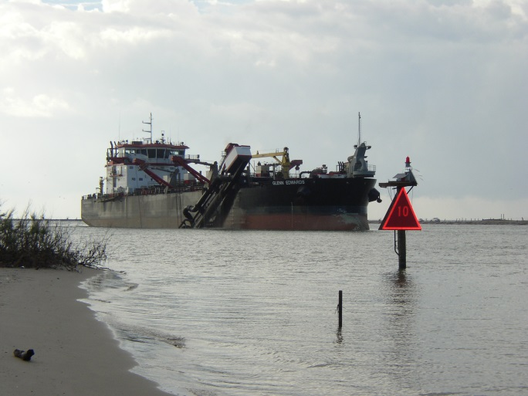
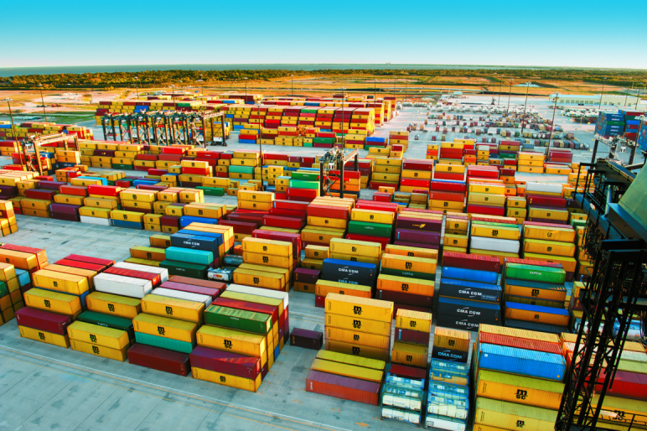
Port Actions
In order to take full advantage of the benefits of the expansion, the Texas maritime transportation system would need to be strengthened or improved
  Channel improvements and maintenance
  New infrastructure to meet growing market demands and to improve operational efficiencies
  Replacement of aging infrastructure
Source: Port of Houston Authority
Notes:
Texas ports are not building on speculation
Almost all Texas ports are engaged in some form of channel deepening and/or widening projects

Slide 14
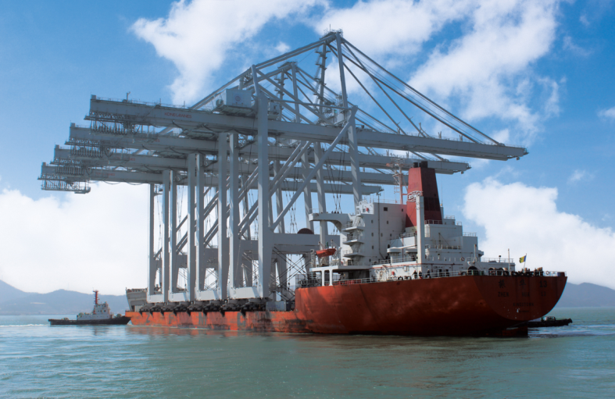
Port Actions
Port of Houston
  Bayport Capital Improvements:
  $540 million
  Barbours Cut Capital Improvements:
  $363 million
  Bayport and Barbours Cut Channel
  deepening from 40ft to 45ft
    Will be able to accommodate 8,000 – 10,000 TEU vessels
    No further deepening due to geographical constraints
  4 new Super Post-Panamax cranes
Port Freeport
  Freeport Harbor Channel Improvement Project
  Post-Panamax cranes
Source: Port of Houston Authority
Notes:
As container ports, the Port of Houston and Port Freeport have taken actions to better accommodate larger container ships
Port of Houston covered the cost of the Bayport and Barbours Cut Channel projects
Freeport Harbor Channel is currently 45 ft and is in the engineering process with USACE to deepen the channel to 55 ft. – If constructed, it will be the deepest port on the Gulf Coast

Slide 15
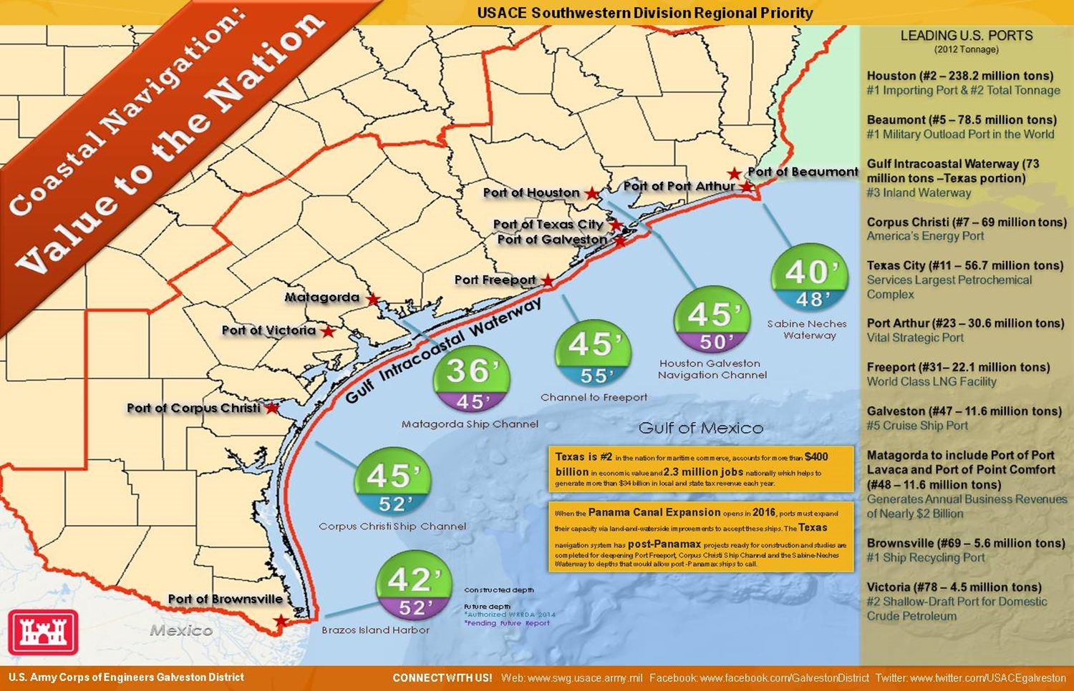
Port Actions
Source: U.S. Army Corps of Engineers

Slide 16
Texas Freight Mobility Plan
The Panama Canal Expansion was identified as one of the major trends likely to impact the future of freight transportation in Texas by the Texas Freight Advisory Committee
As part of the Freight Mobility Plan, TxDOT developed a multimodal Texas Freight Network
  Comprised of rail, highway, airports, and maritime
  Outlines strategic multimodal transportation facilities and corridors that connect Texas’ key trade gateways
  Will be critical in facilitating efficient movement of projected growth in freight volumes
  TxDOT identified over 1,200 multimodal freight transportation projects on the Texas Freight Network totaling $49 billion
Notes:
TxDOT’s first comprehensive multimodal transportation plan that focuses on the state’s freight transportation needs
Approved in January
The information in the following slides comes from the Freight Mobility Plan and does not represent only the Panama Canal’s impact on Texas, but the projection for the future of freight in Texas, including any predicted changes due to the Panama Canal expansion
Represent constraints on transportation infrastructure as population grows and freight transportation increases

Slide 17
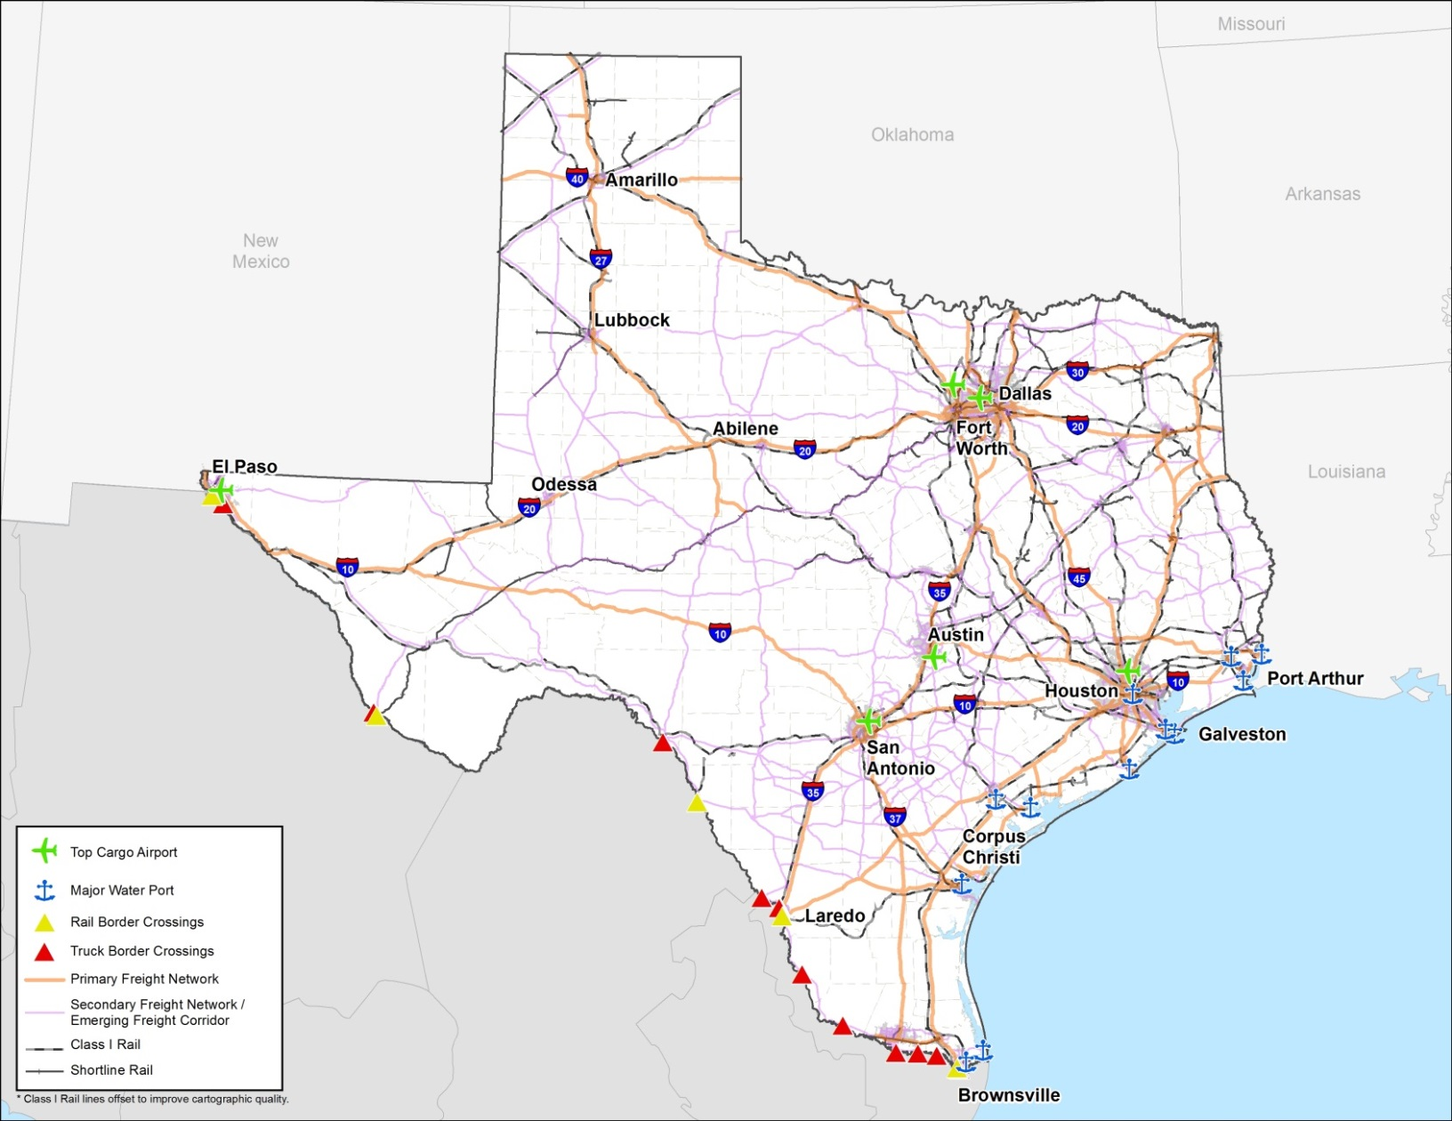
Texas Freight Network
Source: Texas Freight Mobility Plan

Slide 18
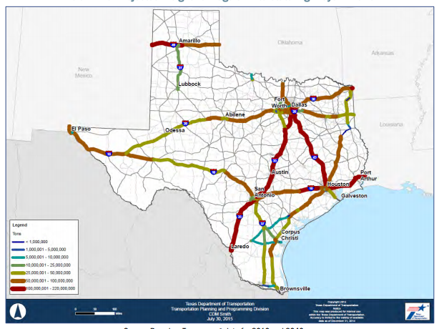
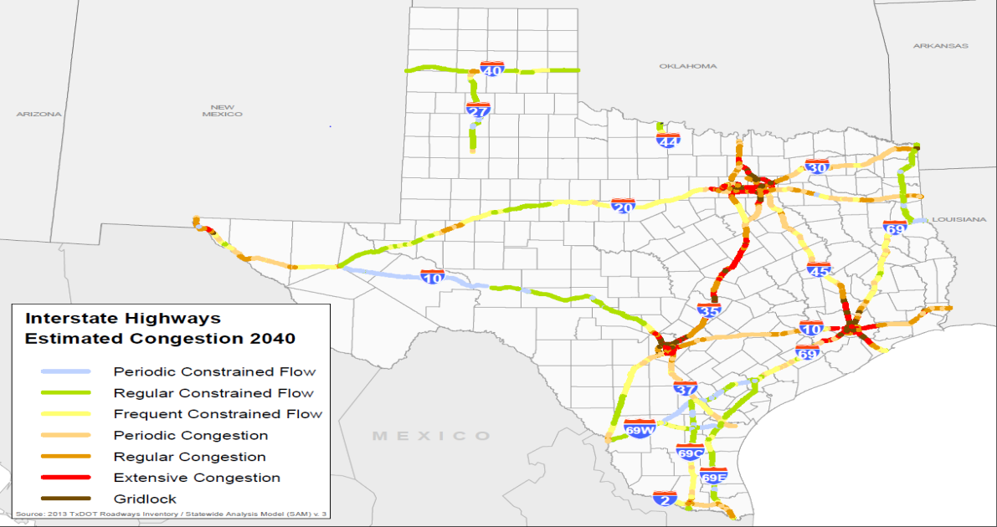
Texas Freight Network (Highways)
2.2 billion tons of freight will move on highways in 2040
Over 80% of truck tonnage will move on Interstates in 2040
Congestion will increase most on interstates in the Texas Triangle region
Over 587,000 daily truck trips in 2040
95 million truck Vehicle Miles traveled in 2040
Source: Texas Freight Mobility Plan
Notes:
Shows the correlation between freight volume growth and increased highway congestion
Truck tons in Texas are expected to increase by 110% to 2.19 billion tons in 2040
The DFW region will see both growth in freight and congestion, partly caused by the Panama Canal expansion
The highest increases in truck volumes impacting the DFW area will by IH-45 and IH-35

Slide 19
Texas Freight Network (Highways)
Today, relatively even tonnage split between truck and rail
By 2040, dramatic shift to truck
Mid-corridor truck composition up to 43% trucks
Critical corridor for handling increased freight from Panama Canal expansion
25% growth
130% growth

Slide 20
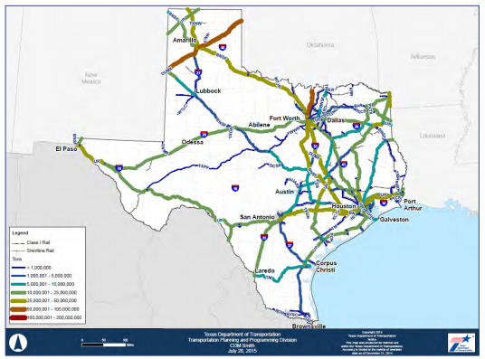
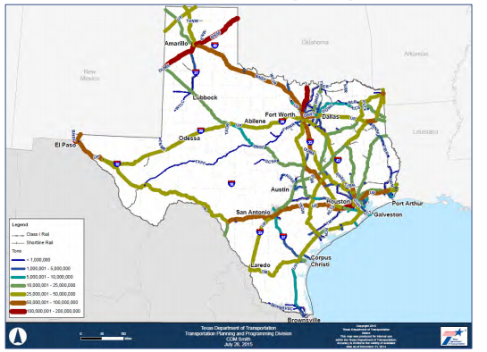
Texas Freight Network (Rail Traffic)
Rail tons expected to increase by 92% to 764.3 million tons in 2040
Greatest increases in rail freight movement impacting Dallas-Fort Worth area:
  BNSF: between Amarillo and Fort Worth
  Union Pacific: Abilene to/from Fort Worth
Rail Freight Tonnage, 2010 and Projected Rail Freight Tonnage, 2040
Source: Texas Freight Mobility Plan
Notes:
Freight rail traffic expected to increase between Abilene/Fort Worth and Amarillo/Fort Worth – Not increased rail traffic from ports

Slide 21
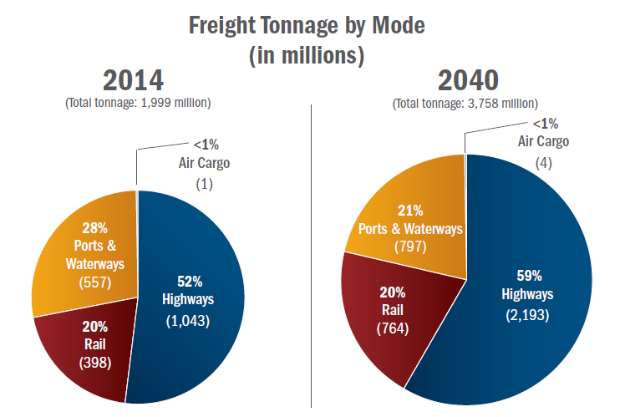
Texas Freight Network (Logistics)
General constraints on freight transportation infrastructure as population increases
Source: Texas Freight Mobility Plan

Slide 22
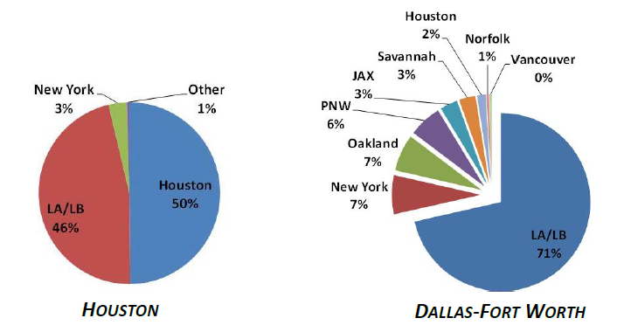
Texas Freight Network (Logistics)
Currently, Port of Houston provides a small share of the DFW market
  Market share may increase with larger ships, provided that there is effective access to the DFW market
Source: Transportation Economics & Management Systems, Inc.
Notes:
DFW is primarily served by LA/LB as well as other non-Texas ports
If conditions change (infrastructure, freight rail rates, etc.) , DFW could be served more by Houston

Slide 23
Conclusions
Some Texas ports will likely experience noticeable increases in cargo volumes
Trade patterns will most likely coincide with population increases and economic growth
The new Panama Canal locks are not expected to dramatically increase freight highway and/or rail traffic in the near term
Resins and LNG are expected to be Texas’ largest export opportunity related to the Panama Canal
More information will be available following the TxDOT RTI study, Impact to Texas’ multi-modal freight networks: Panama Canal and South American Markets (2017)

Slide 24
Questions?
Dan Harmon
Director, Maritime Division
(O) 512/486-5134
(C) 512/284-2317
Dan.Harmon@txdot.gov
http://www.txdot.gov/inside-txdot/division/maritime.html

