Slide 1
Rethinking
Texas Highways
Robert Poole
Director of Transportation Policy

Slide 2
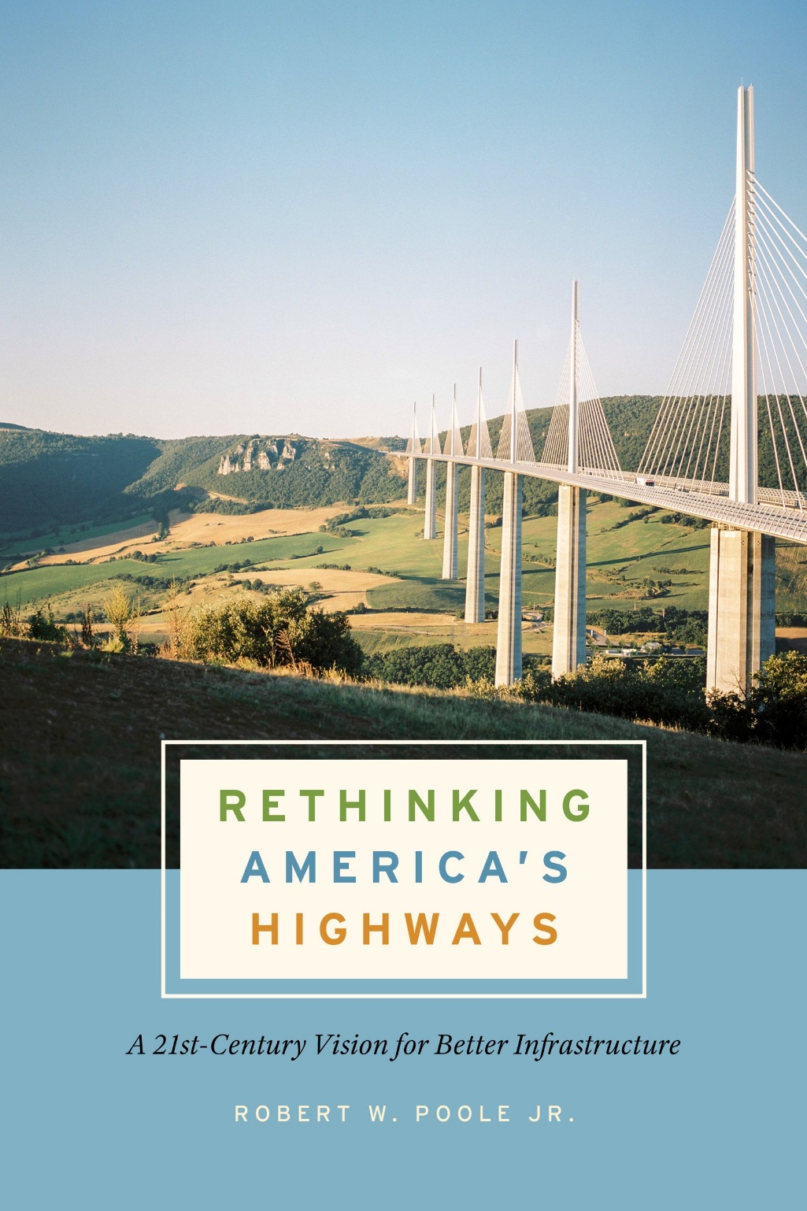

Slide 3
Texas and America’s highway problems
Chronic freeway congestion, especially in fast-growing states like Texas
Ongoing problem of deferred maintenance
Long-term decline of fuel tax revenue
Large backlog of unfunded major projects
Costs of major projects sometimes exceed benefits

Slide 4
A better system would:
Use pricing to manage traffic flow.
Charge customers for what they use.
Select projects with B>C, positive ROI.
Minimize life-cycle costs rather than initial cost.
Guarantee long-term stewardship of the assets.
Finance major projects via revenue bonds.

Slide 5
Highways as a kind of utility
Customers pay the utility directly, based on how much they use.
Pricing depends on the services used.
Major projects are long-term financed, based on customer revenue streams.
Projects show positive ROI, or they don’t get financed.
Ongoing maintenance is built into the financing.

Slide 6
A long-term CDA IS a highway utility
Long-term franchise, like investor-owned electric companies.
Large projects financed with equity and revenue bonds.
Customers pay the provider directly.
Company covers capital & operating costs from user payments.
Regulation of rates & performance by public agency.

Slide 7
Texas began this process—but stopped
Texas pioneered long-term, toll-financed public-private partnerships (P3s) 20 years ago.
In my PWF column Feb. ‘04, I wrote: “I have seen the future of highway finance, in Texas.”
Political opposition led to a legislative ban on TxDOT assistance for P3s (CDAs) and on express toll lanes.
Other fast-growing states attracting large investments for major projects—CO, FL, GA, NC, VA, and soon, TN.
What exactly are P3s (CDAs) and how do they work?
How do priced managed lanes differ from unpriced MLs?

Slide 8
What is a long-term P3 (aka CDA)?
Design-Build-Finance-Operate-Maintain (DBFOM)
Financed either by:
  User fees paid to company by customers (Revenue-Risk P3)
  Availability payments paid by state to company (A-P P3)
Note: P3 is not, per se, a funding source.
P3 is a procurement method.
P3s guarantee long-term stewardship of the assets.
Notes:
Sample Text Slide

Slide 9
Advantages of revenue-risk P3s
Financing project up-front means major projects get built sooner and open sooner.
Risk transfer: cost overruns, late completion, traffic & revenue risk not borne by taxpayers.
Minimize life-cycle cost, not initial cost.
Guaranteed maintenance.
Design innovation.
Incentive for company to attract and please customers.
Large taxpayer savings.

Slide 11
Some non-Texas revenue-risk P3s
Colorado US 36 express toll lanes--$197M
Newark Airport CONRAC--$480M
North Carolina I-77 express toll lanes--$632M
Virginia Mid-Town Tunnel--$2.0B
Virginia I-495 express toll lanes--$2.3B
Virginia I-66 express toll lanes--$3.5B
Georgia: $12B in Atlanta express toll lanes.

Slide 12
Who invests in revenue-risk P3s?
3 main categories:
  Public pension funds
  Insurance companies
  Infrastructure investment funds
Objective: invest equity, seeking low double-digit ROI.
Project finance: typically 25% equity/75% debt.
Equity return not guaranteed; bondholders have priority.
Over $950 billion raised for P3 infra over past 5 years.

Slide 13
Needed P3s for Texas: express toll lanes
Express toll lanes (ETLs) really do reduce congestion.
ETLs are sustainable—reduce vehicle emissions.
ETLs are a powerful express bus transit solution.
ETLs are optional—Tennessee DOT is calling them “Choice Lanes.”
ETL networks are under way in Atlanta, Charlotte, (Dallas), (Houston), Los Angeles, Miami, San Francisco, northern Virginia.
More than 60 ETL projects are in operation nationwide.
Revenue-financed ETLs have investment-grade bond ratings.

Slide 15
Why HOV lanes have failed
TxDOT now plans to add tax-funded HOV lanes in Austin, Dallas, Houston, and San Antonio.
HOV lanes are either too full or too empty.
Most “carpools” are “fampools” which don’t eliminate vehicle trips.
Many vehicles in HOV lanes are cheaters.
While states built HOV lanes, carpooling decreased:
  From 1995 to 2005, HOV lane-miles doubled.
  From 1980 to 2019, carpooling cut in half (from 19.7% to 8.9% of commuters).

Slide 16
Where Texas needs P3 express toll lanes
I-35 though Austin
I-35 in San Antonio
Missing links in Dallas/Ft.Worth express lanes network, including I-635 East
Missing links in Houston express lanes network
“Unpriced managed lanes” are not “managed”; pricing is the key to both:
  Congestion relief, and
  Financing these megaprojects

Slide 17
Keeping Texas competitive
In 2022, Texas was #1 in U-Haul trips from other states.
Of the top 10 U-Haul states, five are adding P3 express toll lanes (Florida, Georgia, North Carolina, Tennessee, and Virginia).
Megaprojects like ETLs should be long-term financed, freeing up TxDOT funds for projects elsewhere in Texas.
Toll-financed projects are long-term protected from deferred maintenance.
Toll-financed projects already have per-mile charging, independent of declining fuel tax revenue.

Slide 18
Benefits for smaller & rural areas
TxDOT HOV plans will cost taxpayers dearly:
  I-35 San Antonio $1.5 billion
  I-635E Dallas $1.7 billion
  I-35 Central Austin $4.9 billion
Total: $8.1 billion
If done as revenue-risk P3s, at least 80% of that sum--$6.5 billion—could be spent on projects in smaller cities and rural areas.
Texans are willing to pay for congestion-relief via express toll lanes!

Slide 19
What’s holding back P3s in Texas?
Contractor opposition is the #1 factor
Claim: CDAs unfair to local contractors:
  Fact: CDA projects depend heavily on local contractors.
Claim: CDAs grab the biggest projects:
  Fact: Revenue-risk CDAs free up TxDOT funds for other projects statewide
  Fact: CDAs expand the size of the construction pie, by raising funds from customers rather than taxpayers.

Slide 20
Other false claims about CDAs
Claim: tolls=taxes
  Fact: tolls are voluntary; ETLs are “choice lanes.”
Claim: CDAs involve mostly government money
  Fact: On average, 80% of revenue-risk CDA is paid for by customer revenues, and in some cases 100%.
Claim: guaranteed profits
  Fact: Equity investors are at risk, and a few such P3s have failed—but there have been NO taxpayer bailouts.
Claim: foreigners buying our highways
  Fact: These are long-term leases, with state DOT regulatory oversight.

Slide 21
Conclusions
CDAs/P3s have been a great success in Texas.
Other fast-growing states are now taking the lead in ETLs and P3s.
Their metro areas will have less future congestion due to ETLs.
Texas major metro areas need ETL networks to be competitive.
Revenue-risk P3 ETL projects could save TxDOT $6.5 billion near-term, to spend elsewhere in the state.
Legislators should consider and quantify the potential statewide benefits of a resumed CDA/P3 program.

Slide 22
Questions?
Contact information:
Bob.Poole@reason.org

