Slide 2
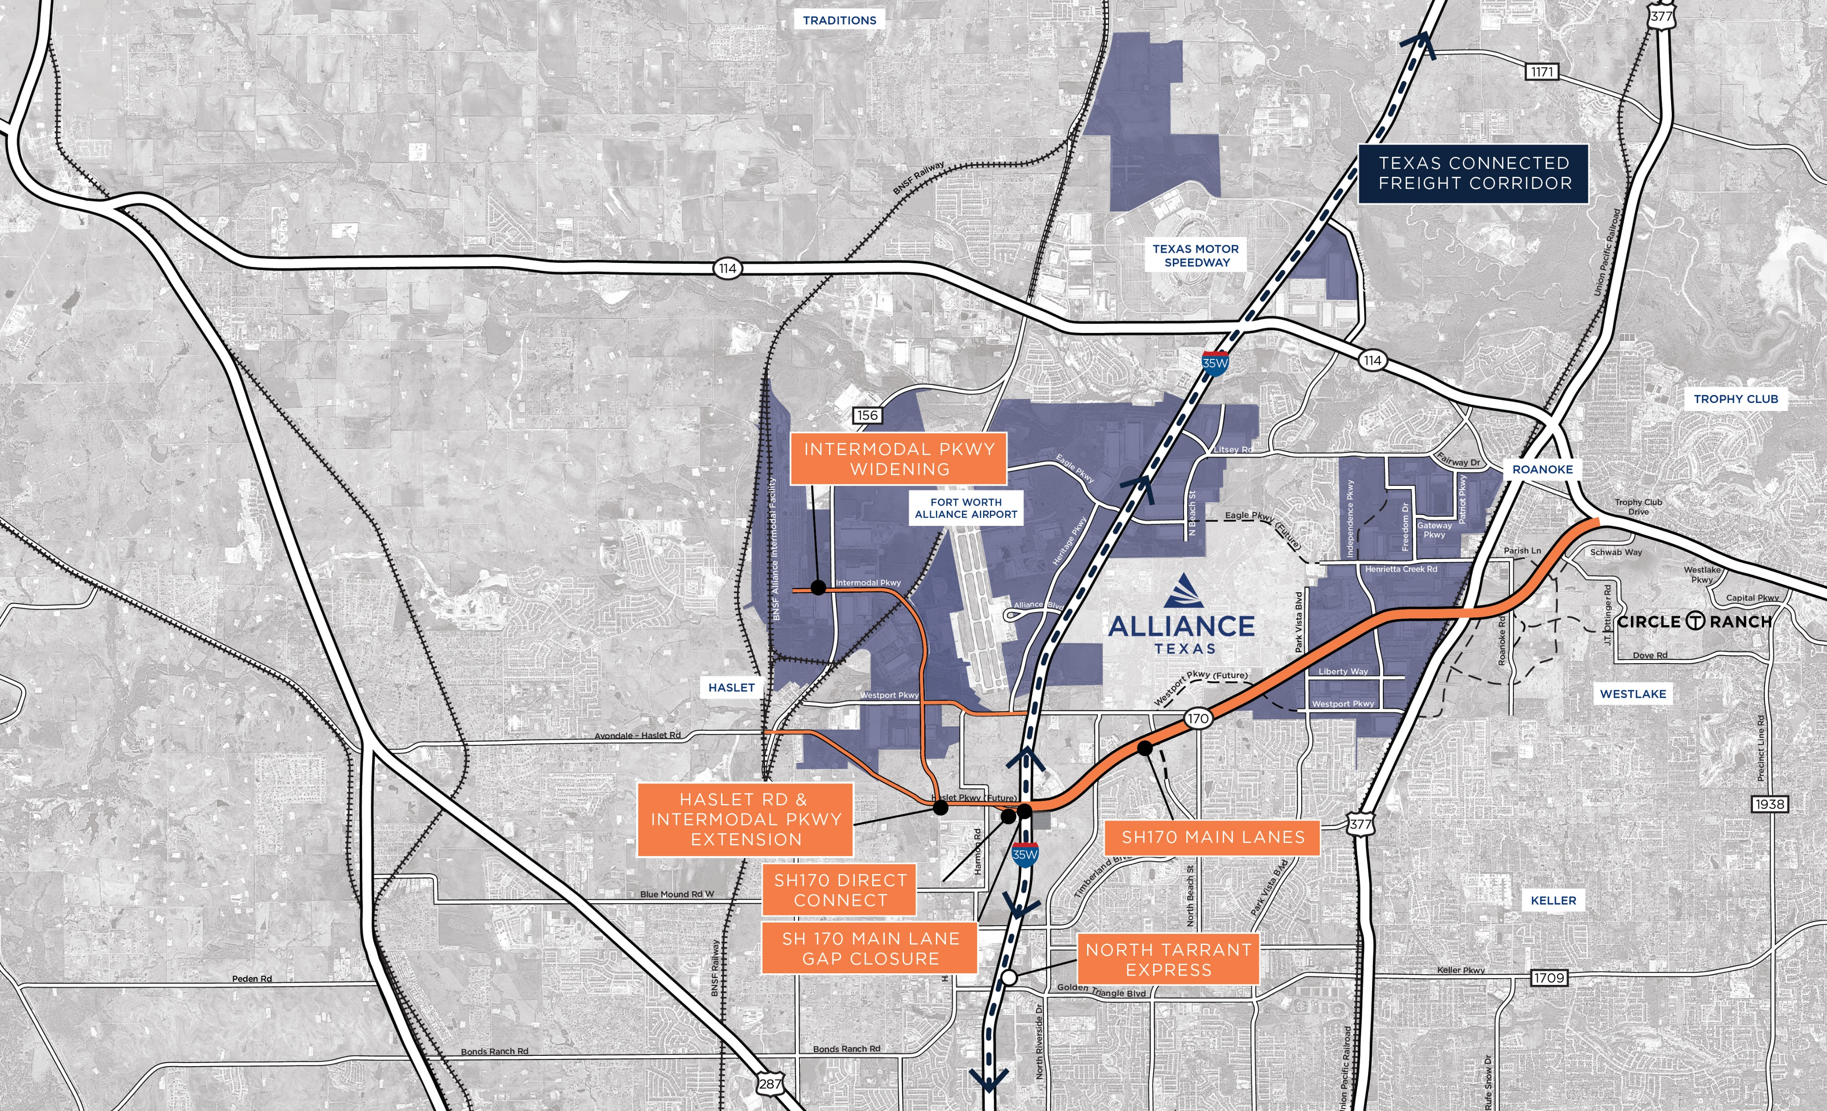
Regional Level Projects
Intermodal Pkwy. Widening
Haslet Rd. & Intermodal Pkwy. Extension
Intermodal Pkwy/ SH 170 Direct Connectors
SH 170 Main Lane Gap Closure
SH 170 Main Lanes
North Tarrant Express
ALLIANCETEXAS / MOBILITY INNOVATION ZONE
2

Slide 3
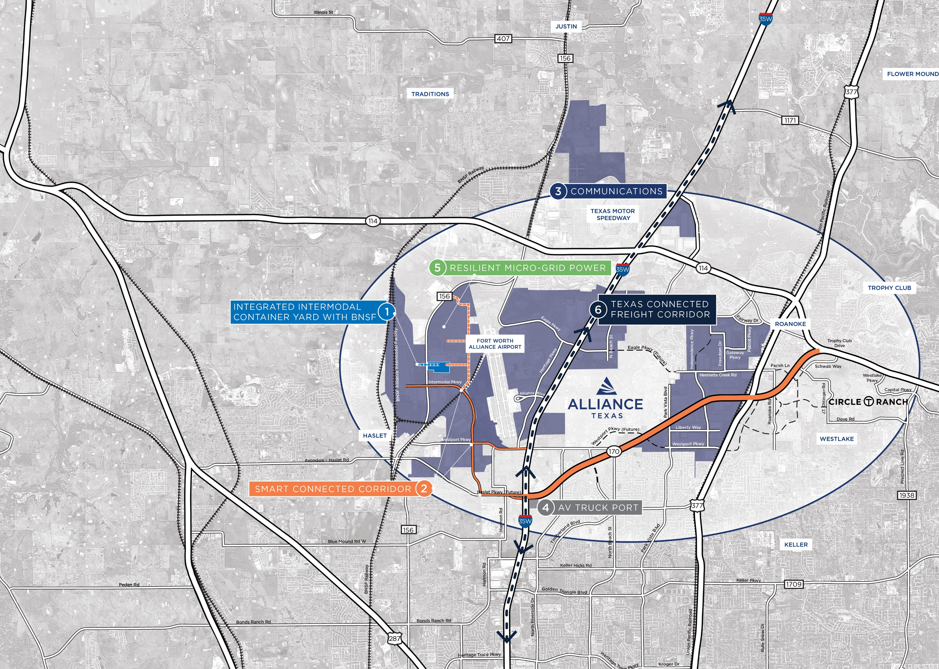
AllianceTexas Smart Port
Integrated Intermodal Container Yard with BNSF
Smart Connected Corridor
Communications
AV Truck Port
Resilient Micro-Grid Power
Texas Connected Freight Corridor
ALLIANCETEXAS / MOBILITY INNOVATION ZONE
3

Slide 4
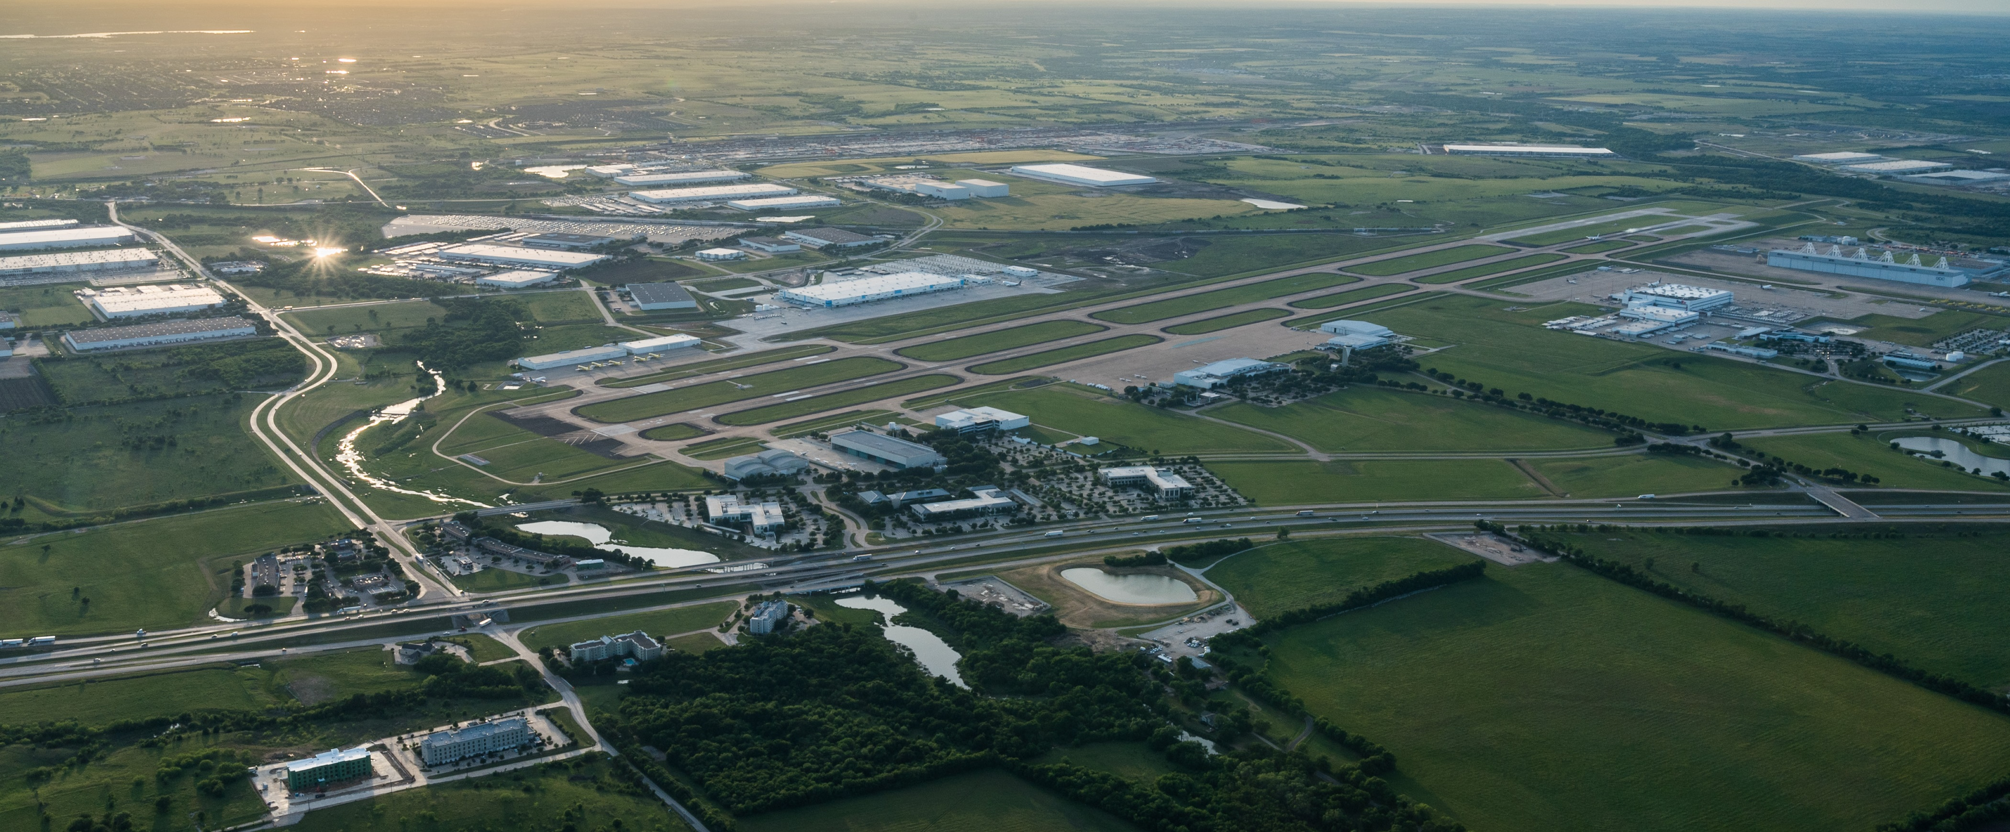
Smart Port Progression Plan
INTEGRATED INTERMODAL CONTAINER YARD WITH BNSF
SMART CONNECTED CORRIDOR
COMMUNICATIONS
AV TRUCK PORT
RESILIENT MICRO-GRID POWER
TEXAS CONNECTED FREIGHT CORRIDOR
PURPOSE:
Provide long-term comms capacity across Alliance
Support public & private 5G deployments
Fiber backbone for AV tech deployments
PARTNERS:
PURPOSE:
Regional node supporting long- and short-haul operations
Truck & container queuing and hand-offs
Data hub with alternative fueling capabilities
PARTNERS:
PURPOSE:
Integrate Smart Corridor to TCFC
Optimize border-to-border freight with one of the nation’s top 50 in-land ports
Leverage AV technologies to support nation’s supply chain
PARTNERS:
PURPOSE:
15-mile corridor supporting V2X technologies
Enhanced supply chain efficiency, safety & resiliency
Integration into TCFC
PARTNERS:
PURPOSE:
Solve energy capacity gaps for strategic industries
Create resiliency and reliability to grid power
Manage energy demand spikes
PARTNERS:
PURPOSE:
Direct, private connection to BNSF
Optimized container movements to industrial platform
Reduction in regional traffic congestion and emissions
PARTNERS:
4

